Slide 1
Hospital Management System

Slide 2
Group -3 Team Members
2530363 - NandhaKumar Velumani
2529033 - Gokulrajan Nagarajan
2529519 - Mahesh M
2529221 - Jimms Mathew
2528983 - Suriya Ramesh
2529230 - Venkat Kumar P J
2528835 - Mohamed Yoosuf I
2528010 - Cheethirala Manasa
2528574 - Basava Rishitha
2530554 - Aisshwarya N S

Slide 3
Contents
Aim
Objective
Introduction
Why Hospital Management System
System Requirements
Tools and Languages
Modules (Admin, Doctor, and Patient)
Testing
Advantages and Disadvantages
Conclusion

Slide 4
Aim
Create a dynamic and responsive Java Hospital Management Web application for managing inventory and laboratory management, as well as patient registration.

Slide 5
Objective
The main objective is to build a management system to computerize every activity.
To provide effective management of data so that it would be easy to access 24/7.
To provide a bug-free application to the admin, doctor, and patient.

Slide 6
Introduction
Hospital Management System is a web application and an online solution for hospitals to manage their doctors, employees, and patients. HMS is using Java as the core programming language and Spring boot to handle the controller’s requests and responses. JPA with hibernate to manage the database transactions and MYSQL database to store the data.

Slide 7

Why Hospital Management System
To control operations like
Database Management
Booking an appointments
Billing
Patient Medical History

Slide 8
System Requirements
The basic System Requirements to execute the project are listed below
Visual Studio, Eclipse, and MySQL
Microsoft Windows 10,11
Web Browser(Microsoft Edge, Google Chrome, Firefox)

Slide 9

Tools and Languages
Front End
HTML
CSS
Angular
Bootstrap
Back End
MySql
Hibernate
Spring Boot
Postman(Testing)

Slide 10
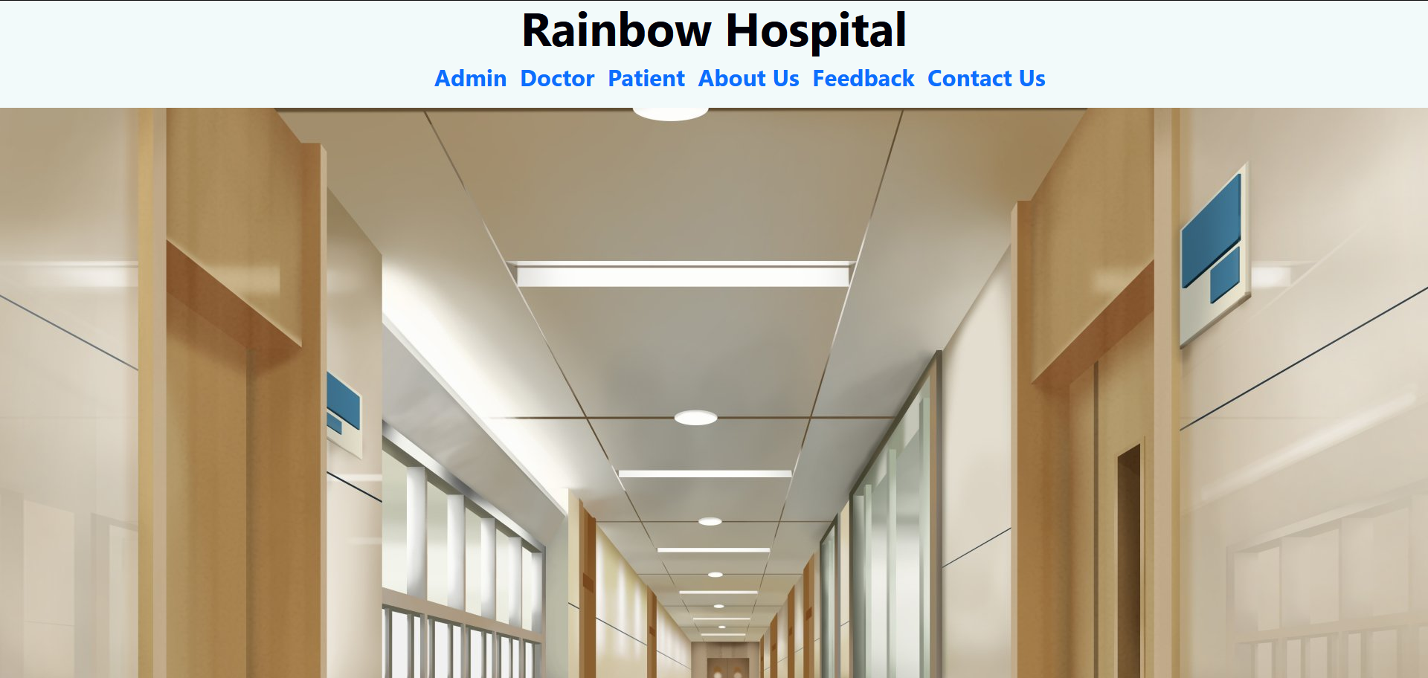
HOME PAGE

Slide 11
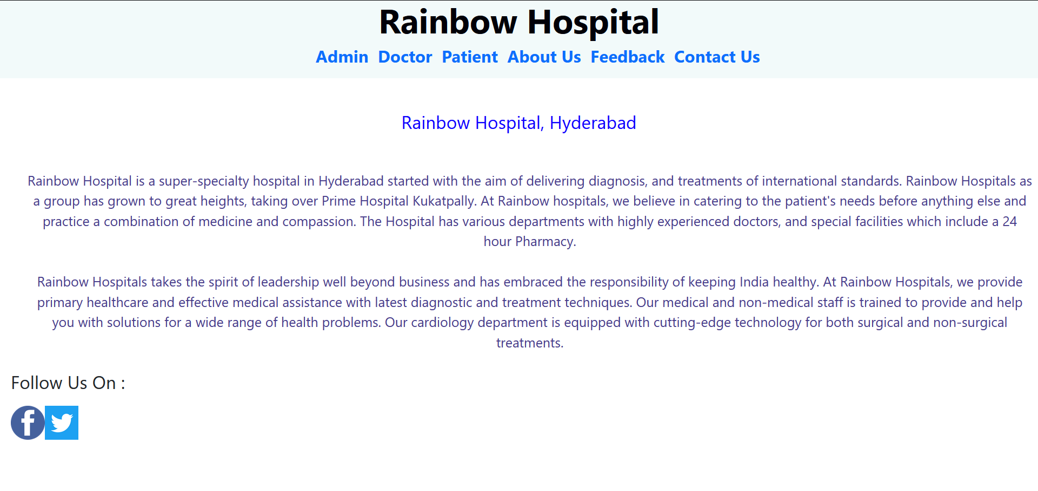
About us

Slide 12
Modules
Doctor
Signup
Login
Appointment list
Discharged list
Admin
Login
Create Admin Account
Doctor List
Patient List
Feedback
patient
Signup
Login
Doctor details
Discharge form
Appointment registration

Slide 13
ADMIN MODULE
In the Admin Module the Admin could sign-up and login
The Admin can see the Doctor List, Patient List, and Feedback
In the Doctor’s List, the Admin can perform CRUD operations like UPDATE and DELETE
In the Patient’s List the Admin can perform CRUD operations like UPDATE and DELETE

Slide 14
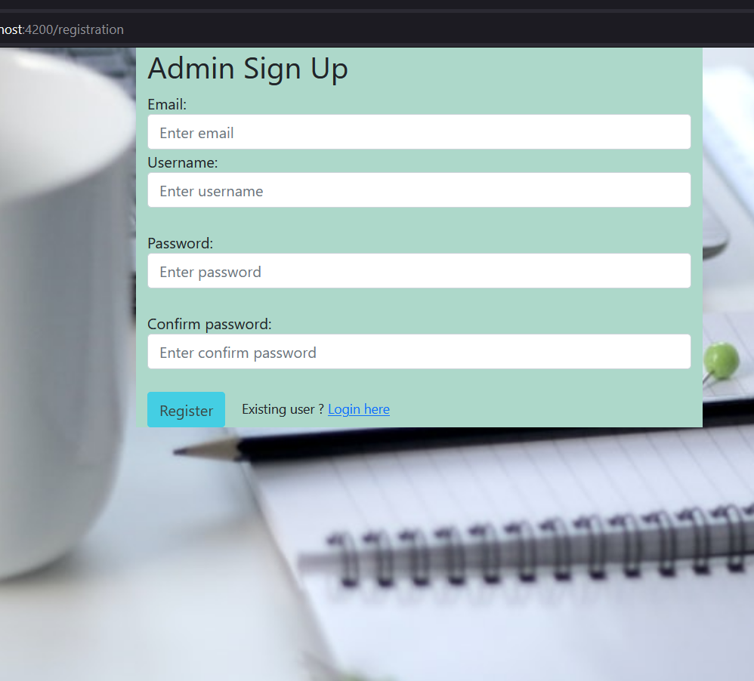
Admin Sign Up

Slide 15
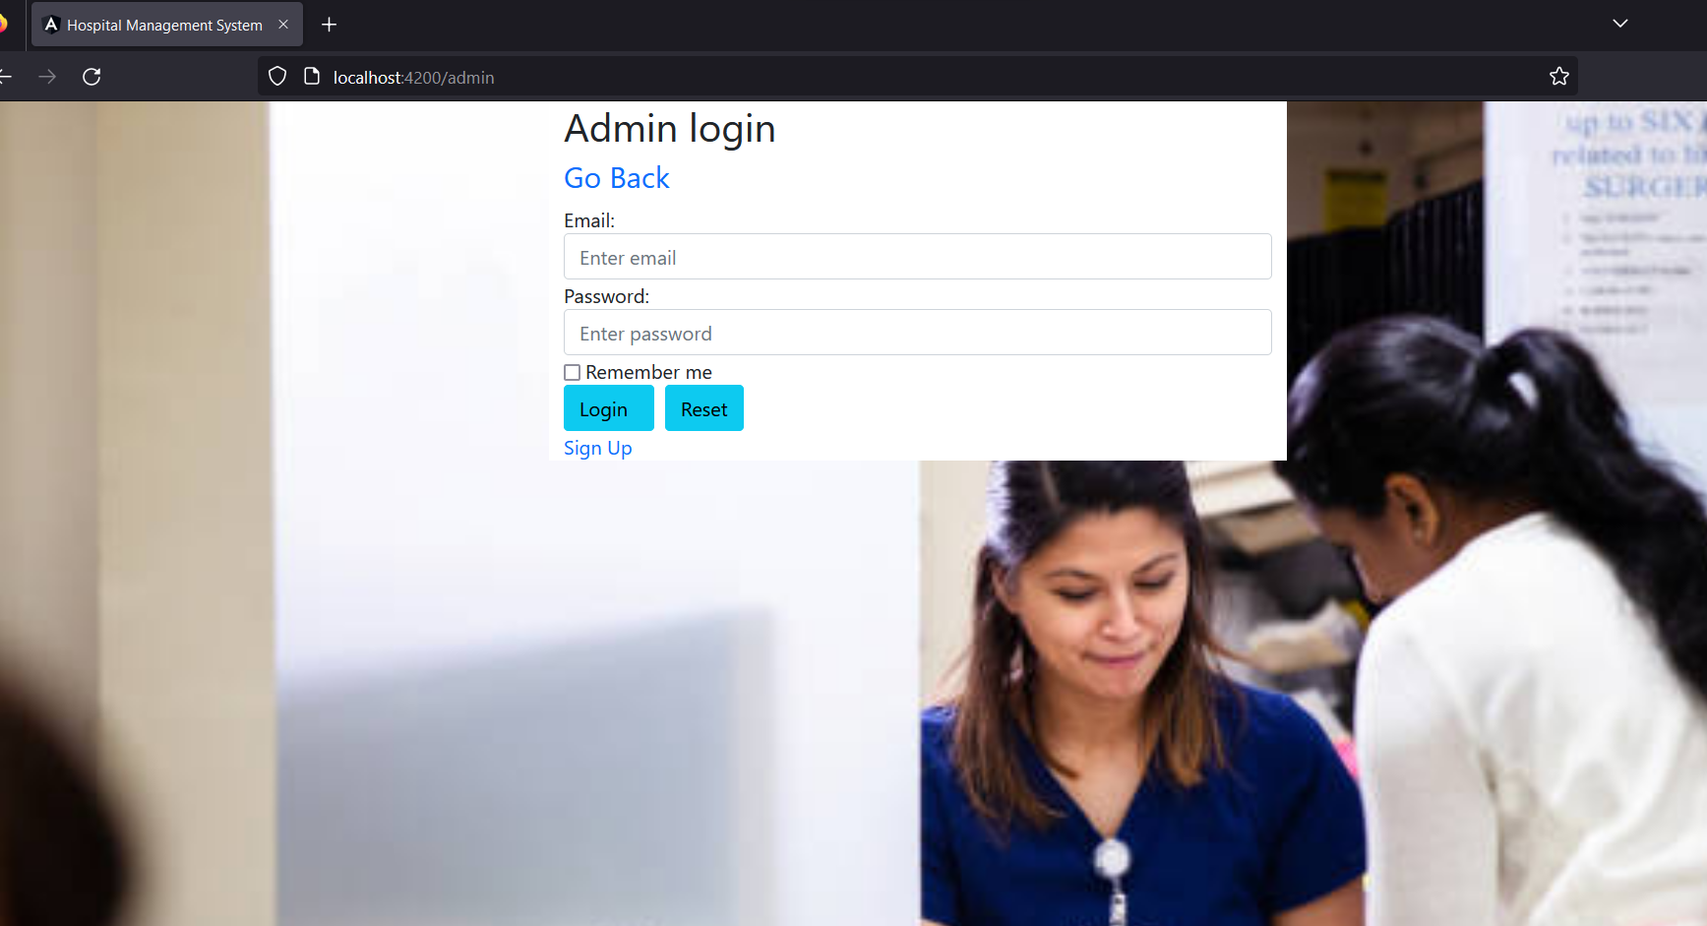
Admin Login

Slide 16
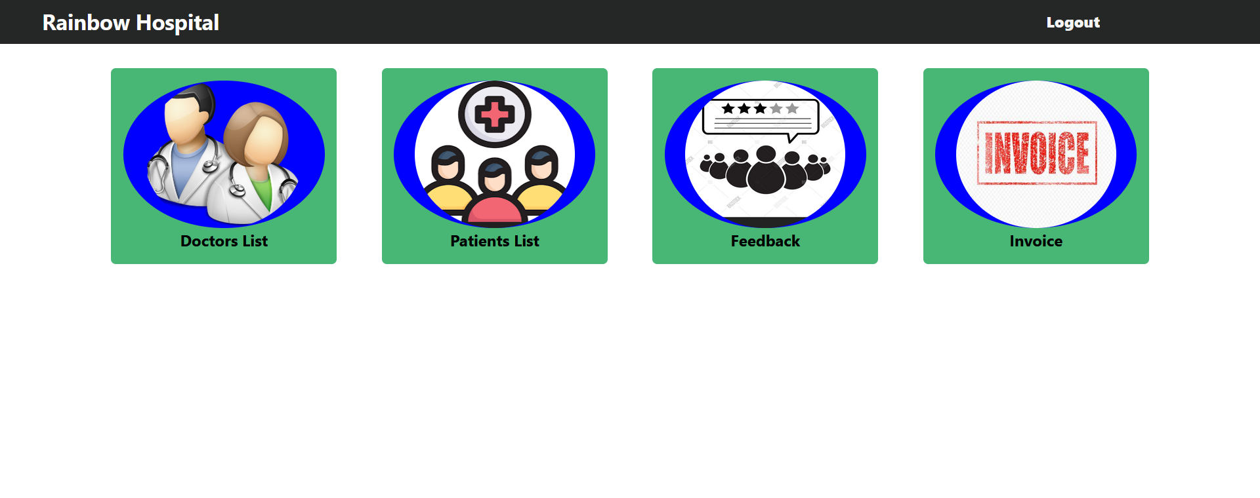
Admin Dashboard

Slide 17

DOCTOR MODULE
Doctor can Sign-up and Login
Doctor can see the Appointment and Discharge List
Doctor can DELETE the Appointments once attended

Slide 18
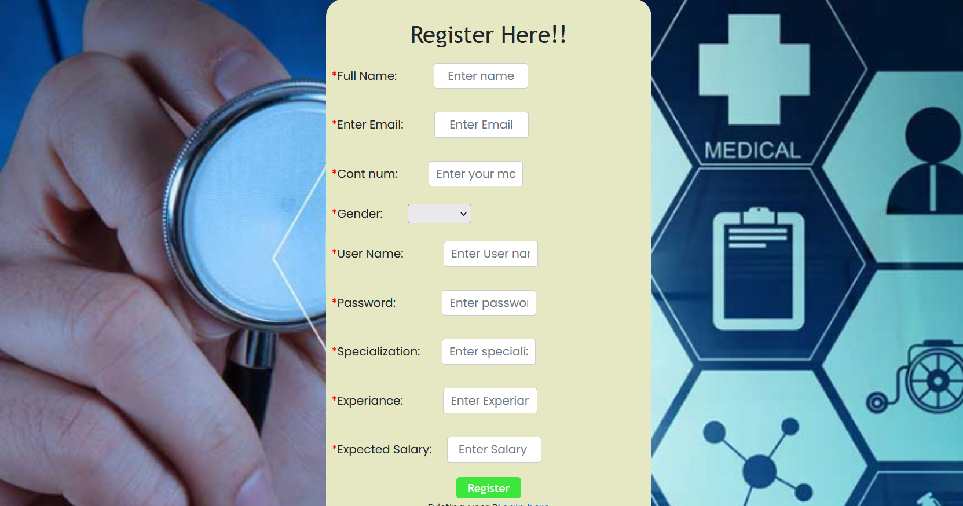
Doctor Sign Up

Slide 19
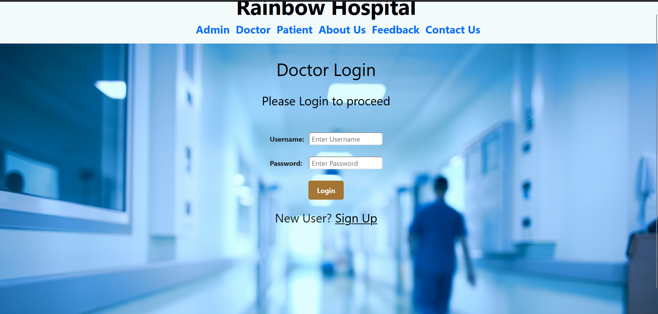
Doctor Login

Slide 20
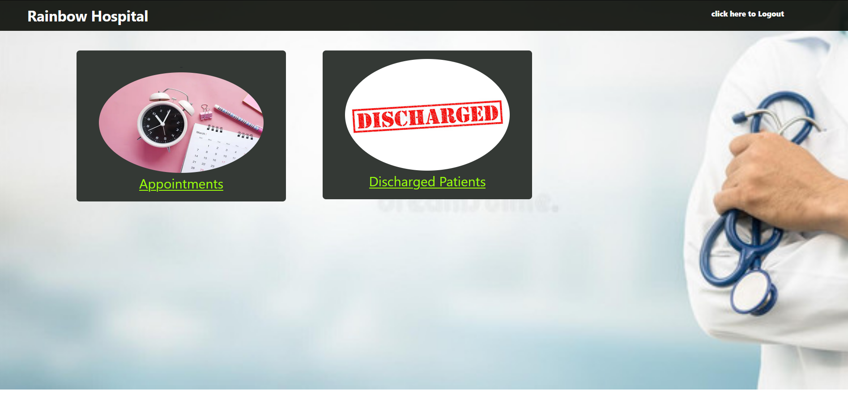
Doctor Dashboard

Slide 21

PATIENT MODULE
Patient can Sign-up and Login
Patient can register the Appointment
Patient can see the Doctor who is allotted by the admin
Patient can give the Feedback about the service provided by the hospital

Slide 22
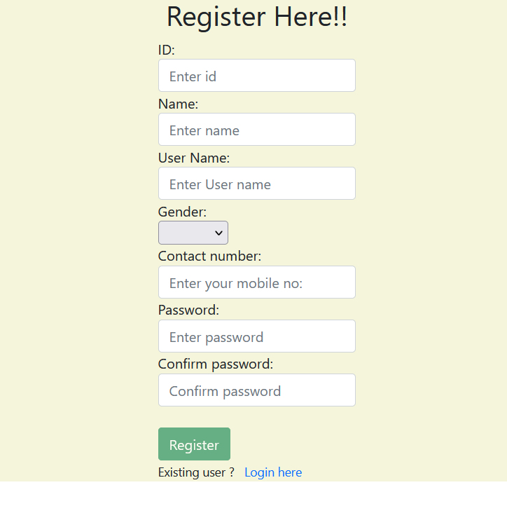
Patient Sign Up

Slide 23
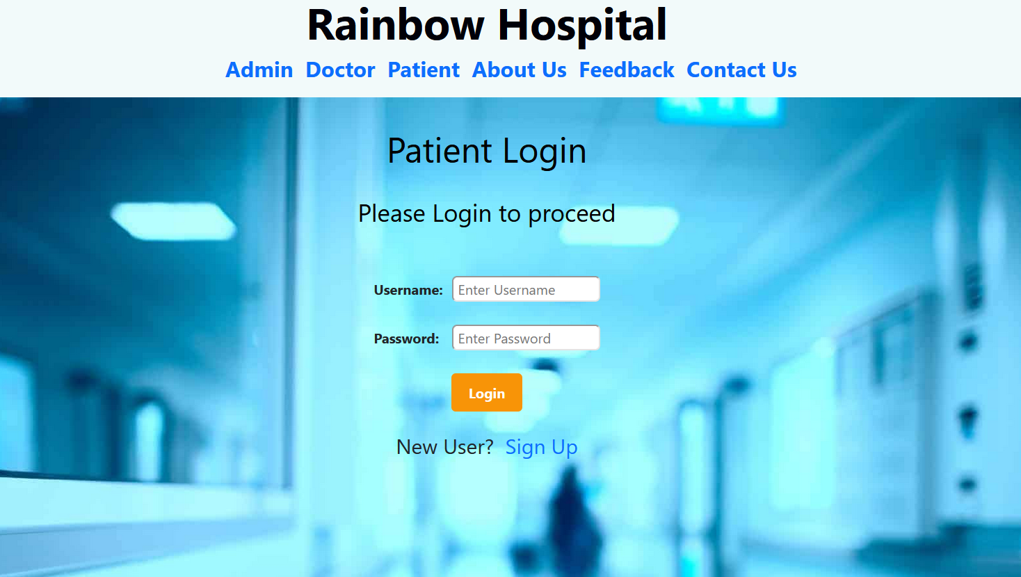
Patient Login

Slide 24

Patient Dashboard

Slide 25
Advantages
Time-saving Technology
Improved Efficiency by avoiding human errors
Reduces scope for Error
Data security and correct data retrieval made possible
Cost-effective and easily manageable
Easy access to patient data with correct patient history
Easy monitoring of supplies in inventory
Reduces the work of documentation
Better Audit controls and policy compliance.

Slide 26
Disadvantages
Lack of employment is another such thing. The chances of employment usually become less with the automation of the system.

Slide 27
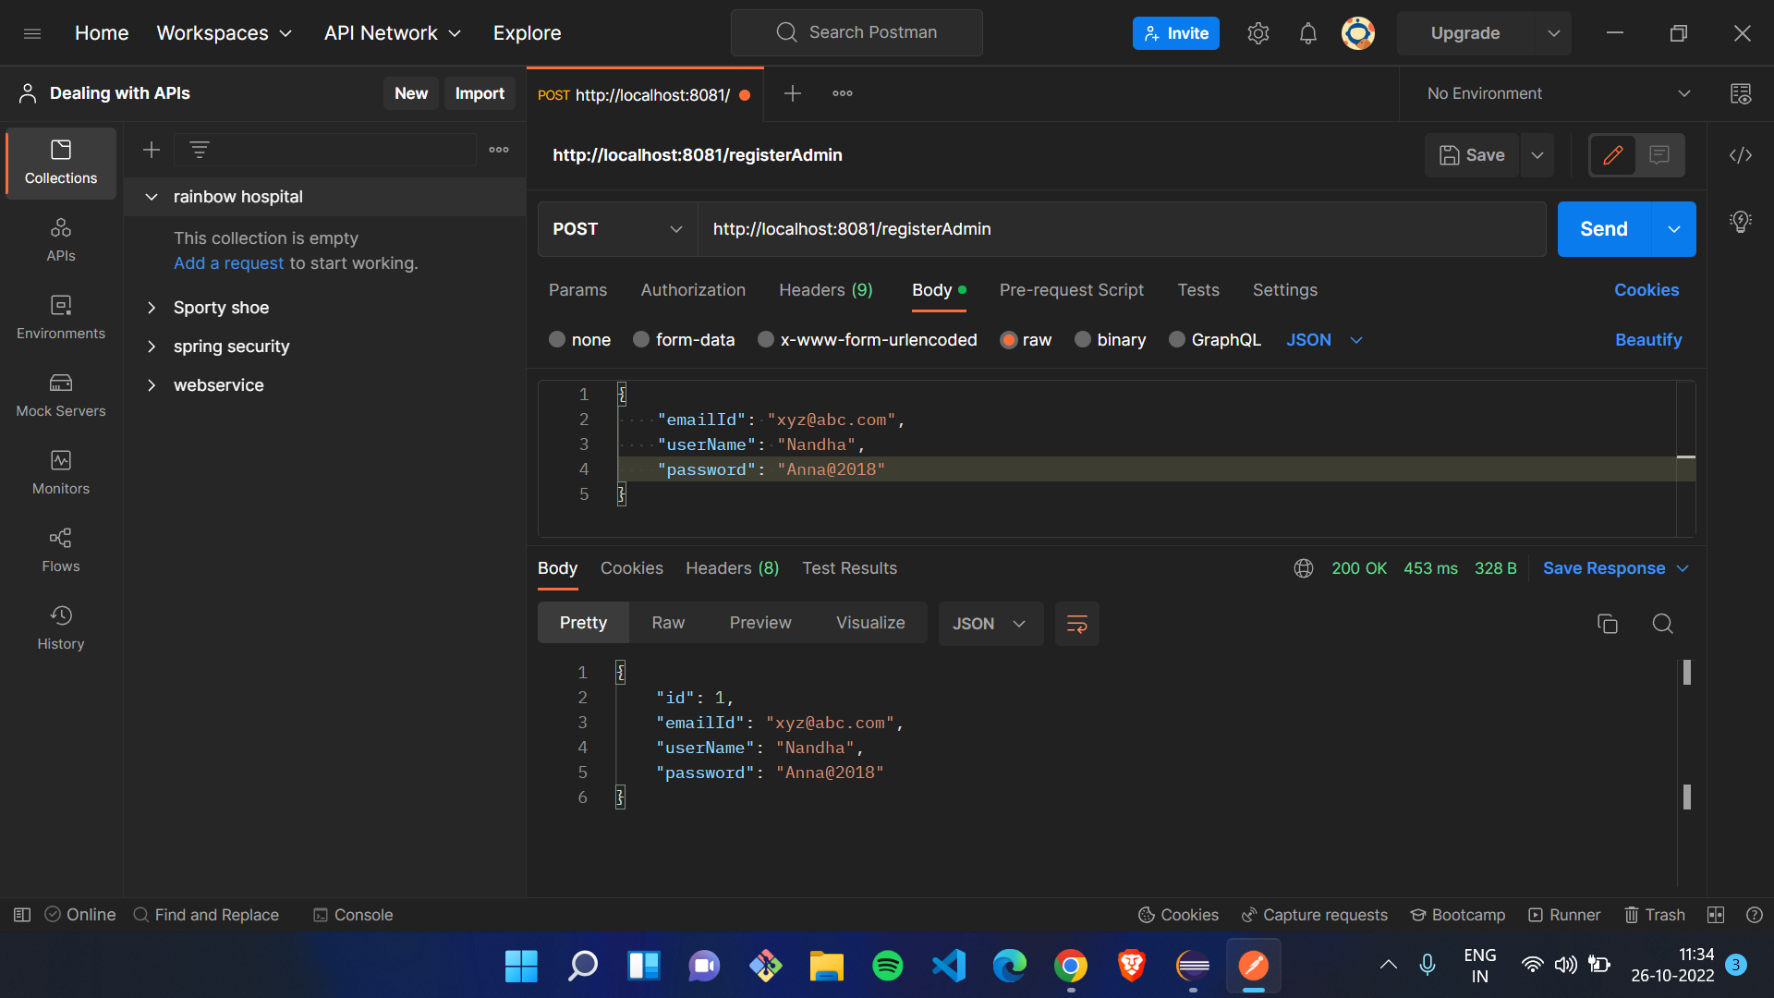
Testing

Slide 28
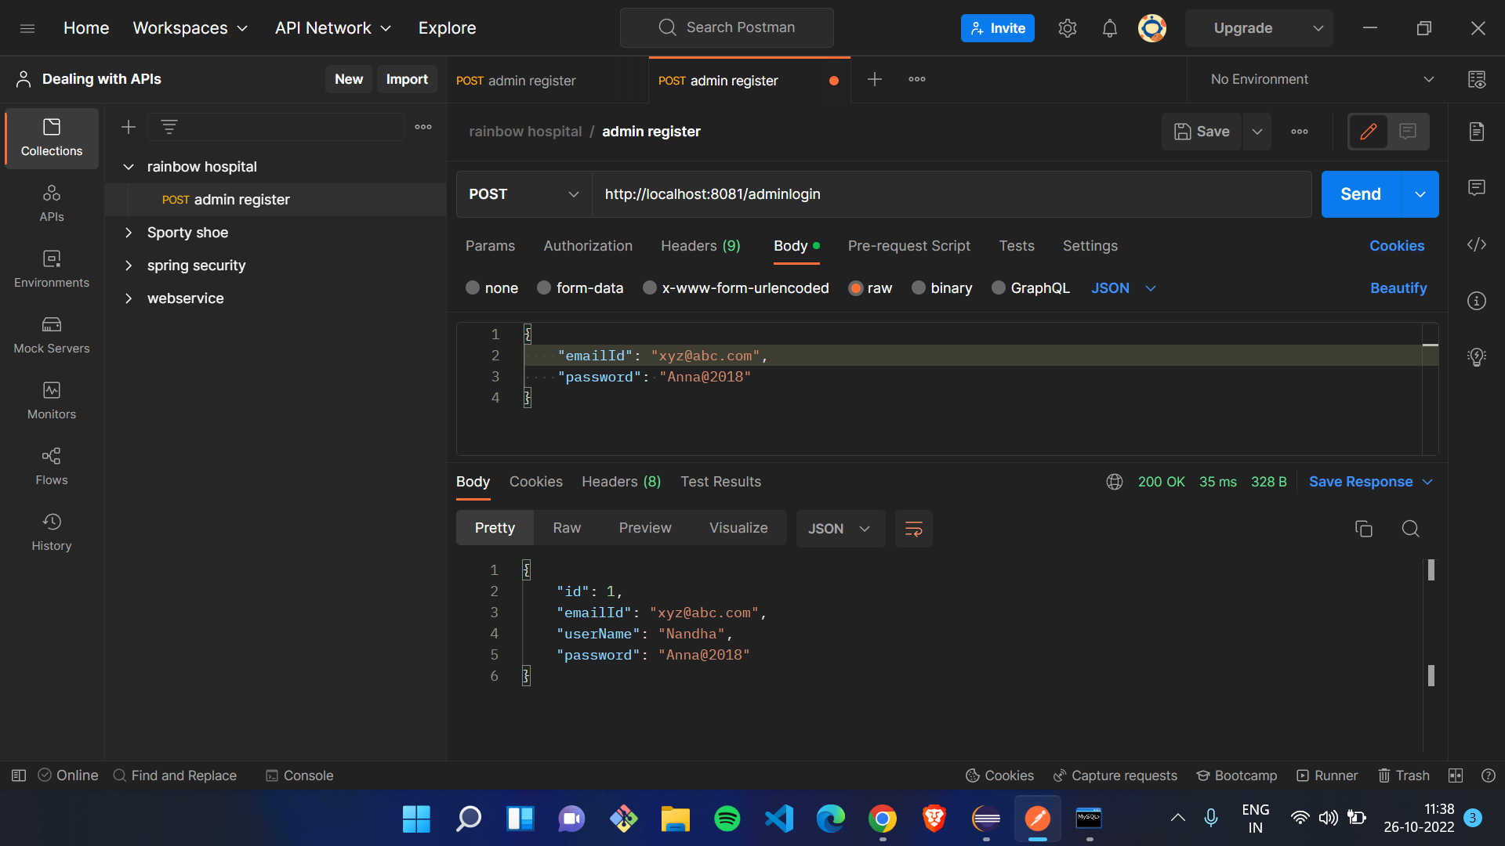

Slide 29
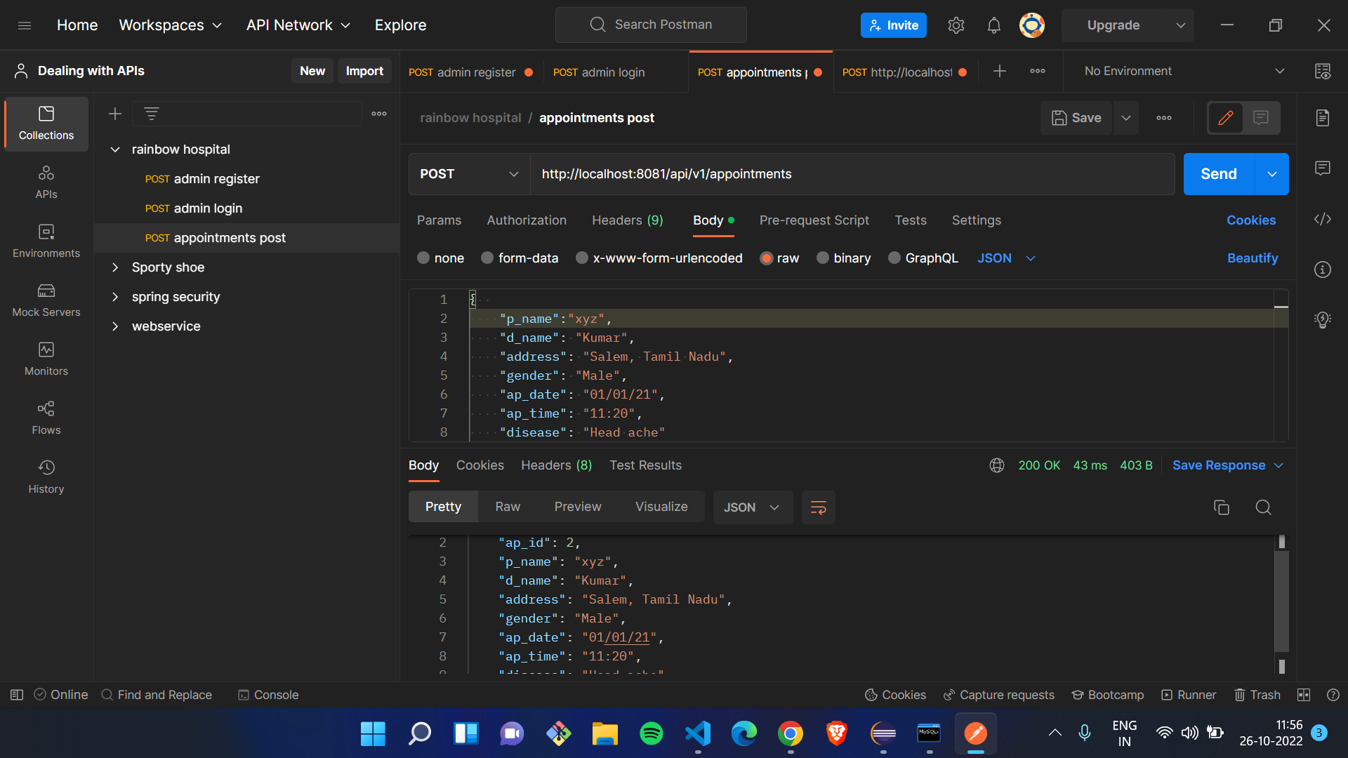

Slide 30
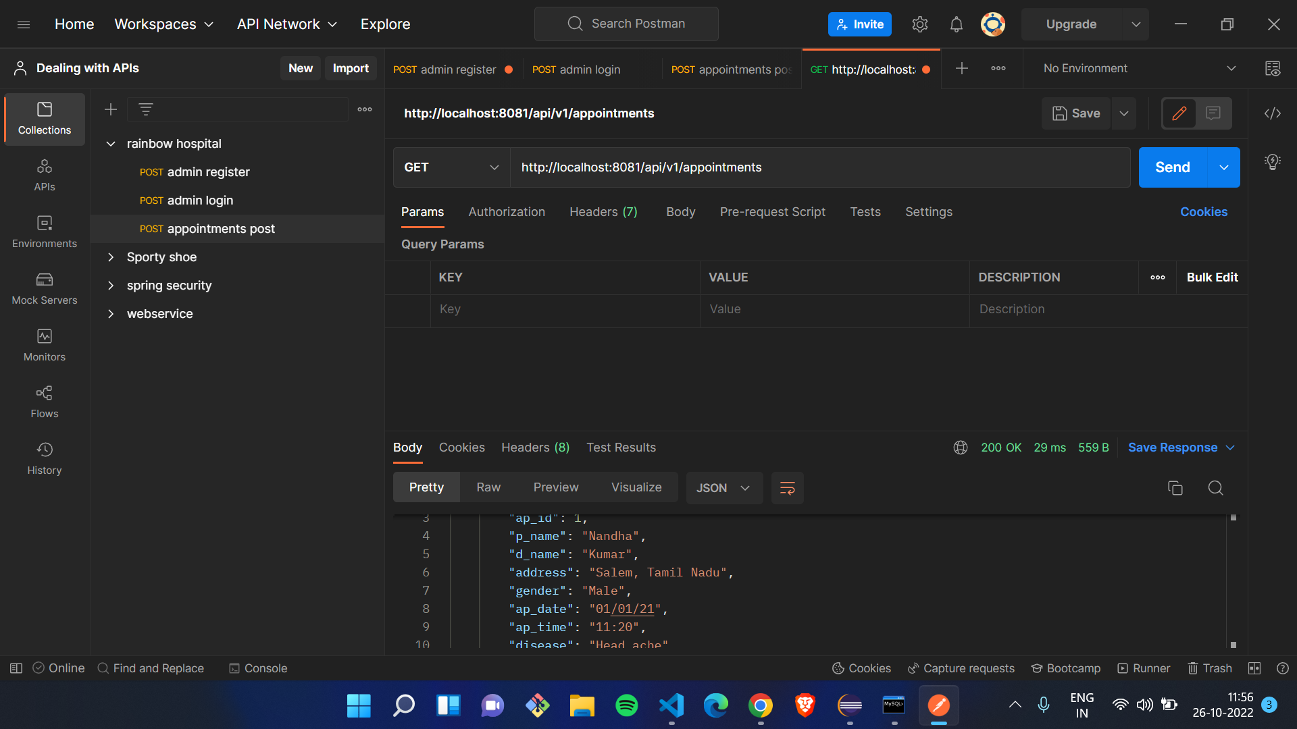

Slide 31
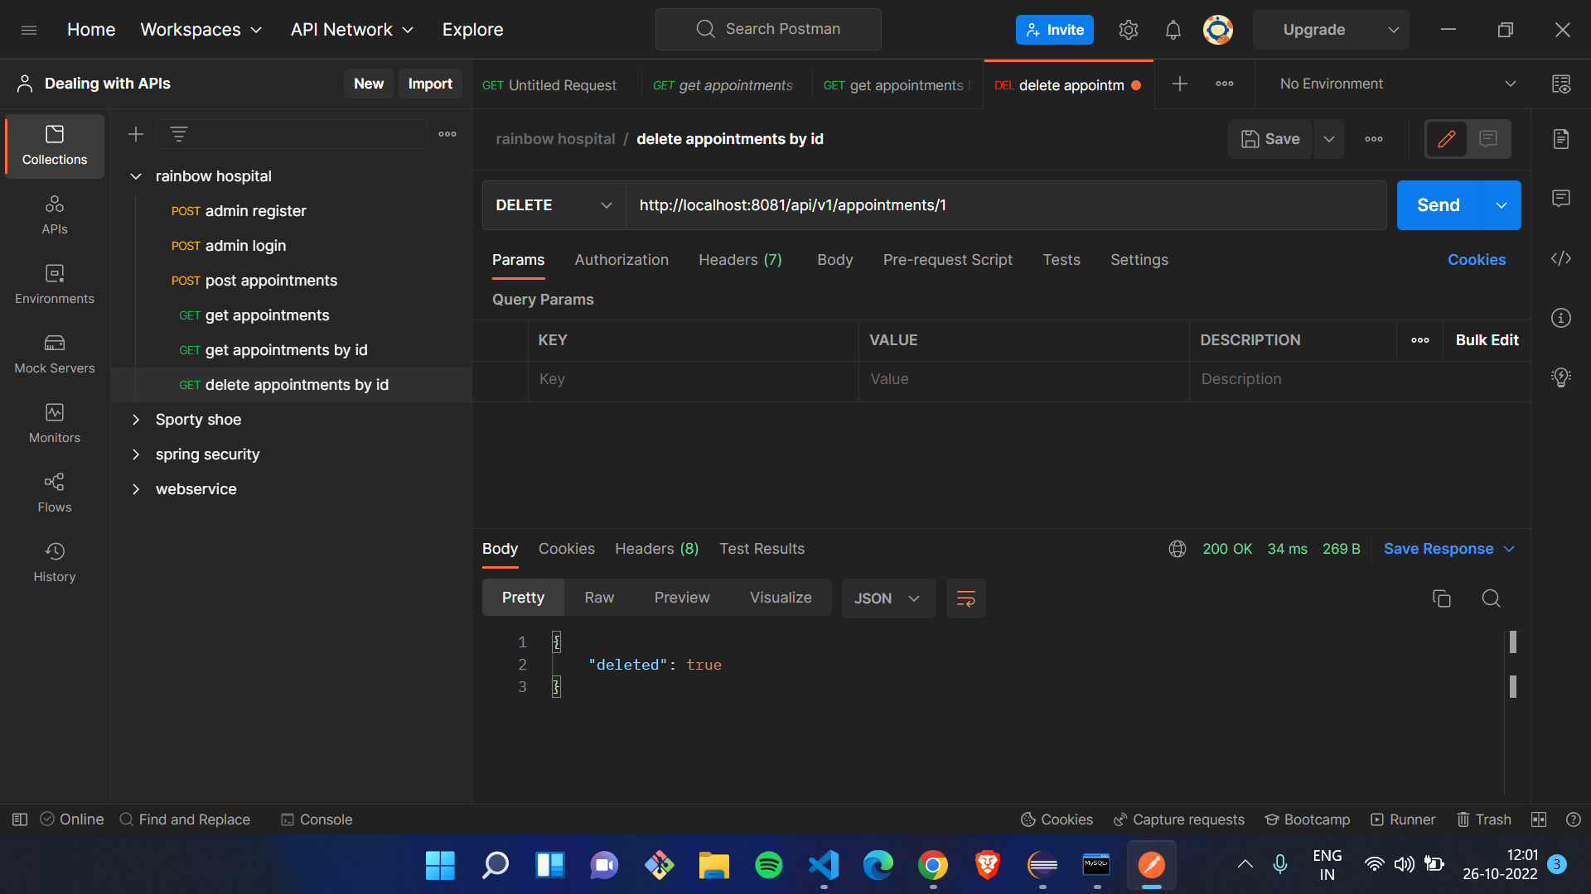

Slide 32
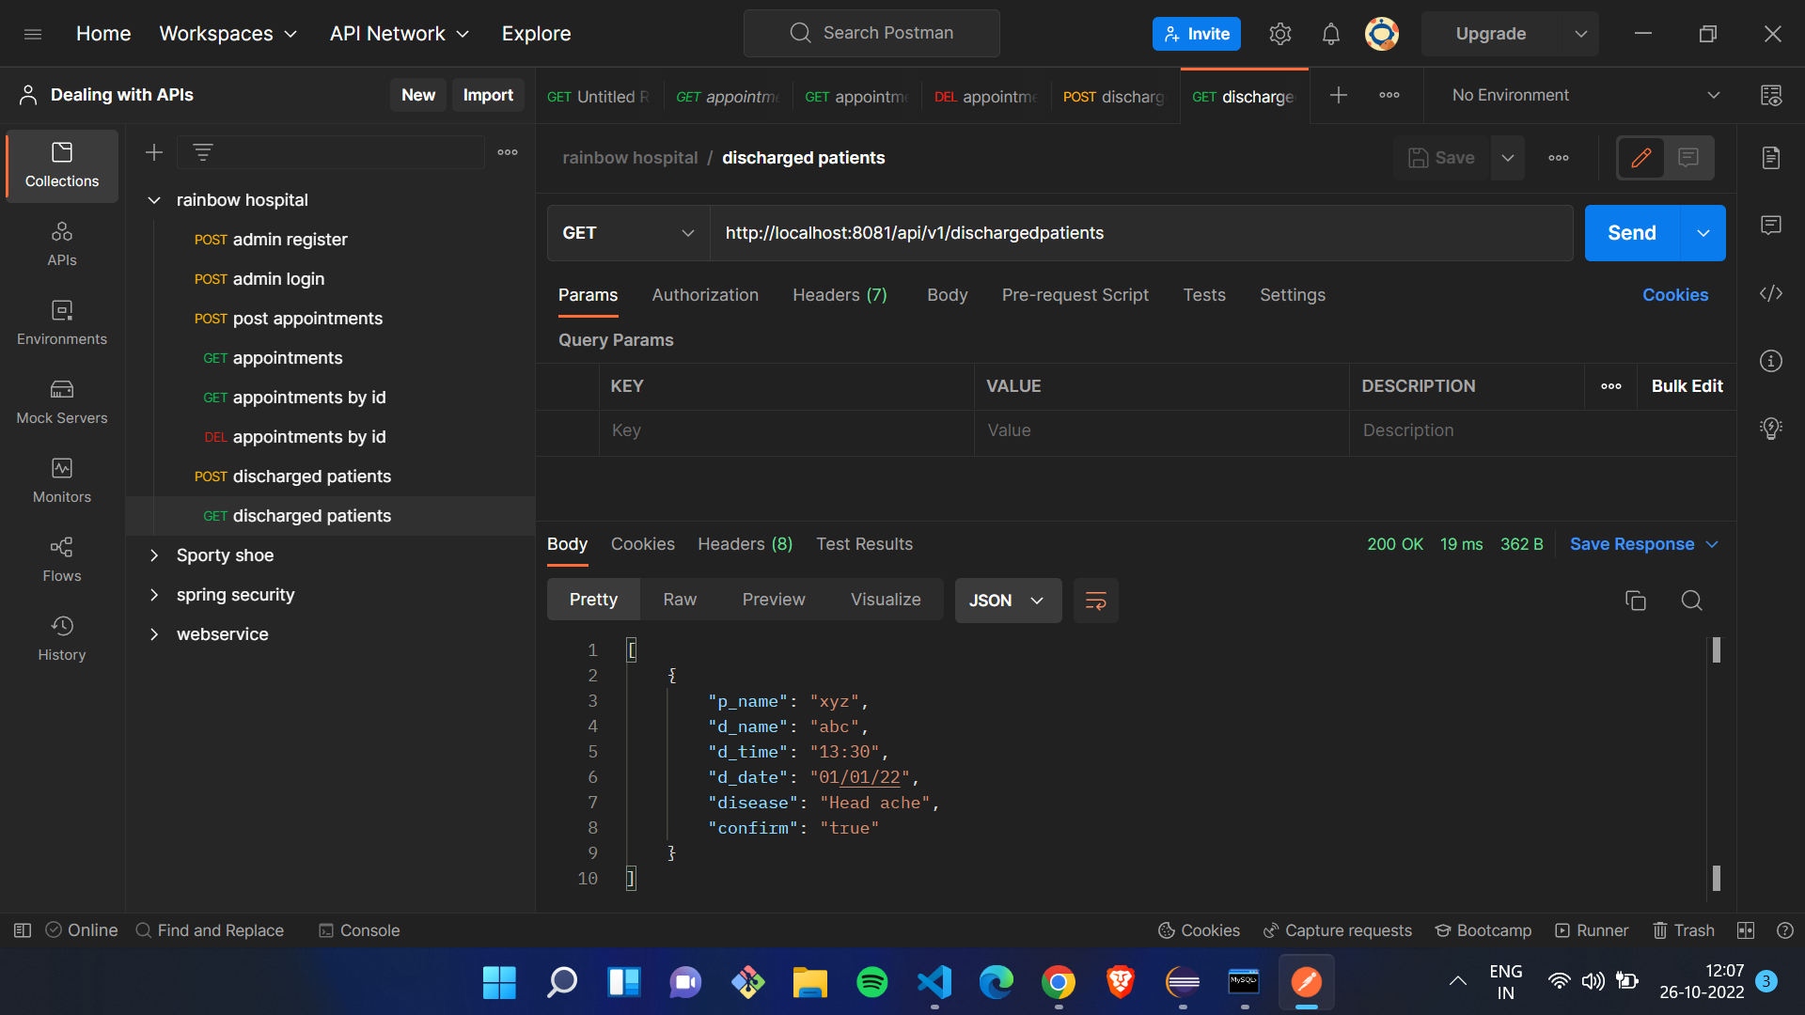

Slide 33
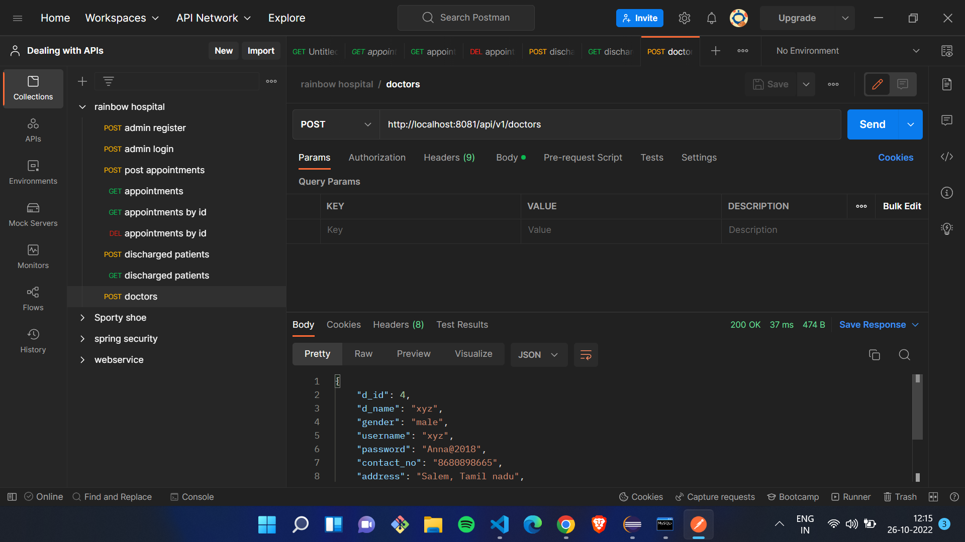

Slide 34
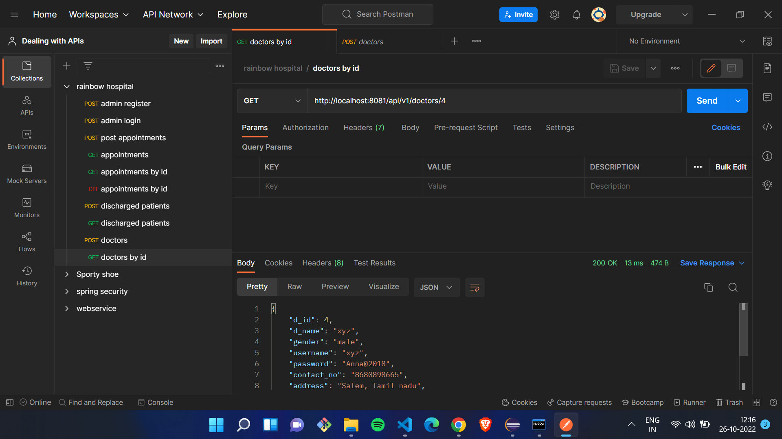

Slide 35
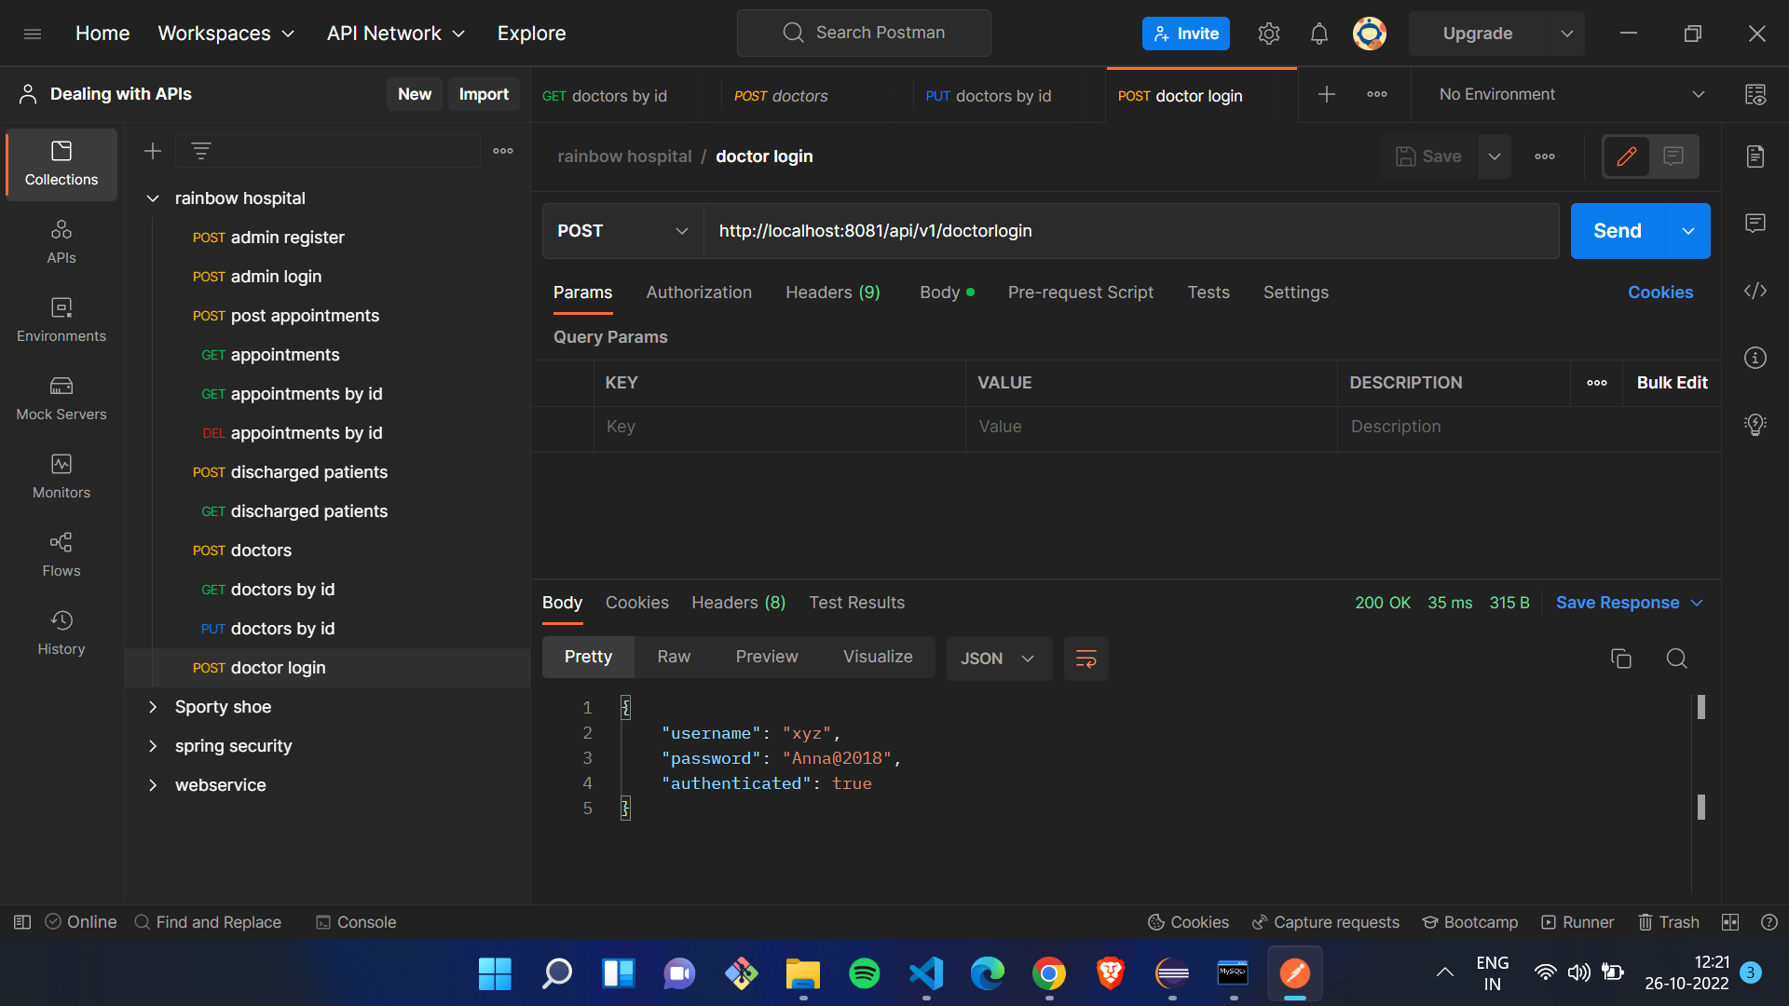

Slide 36
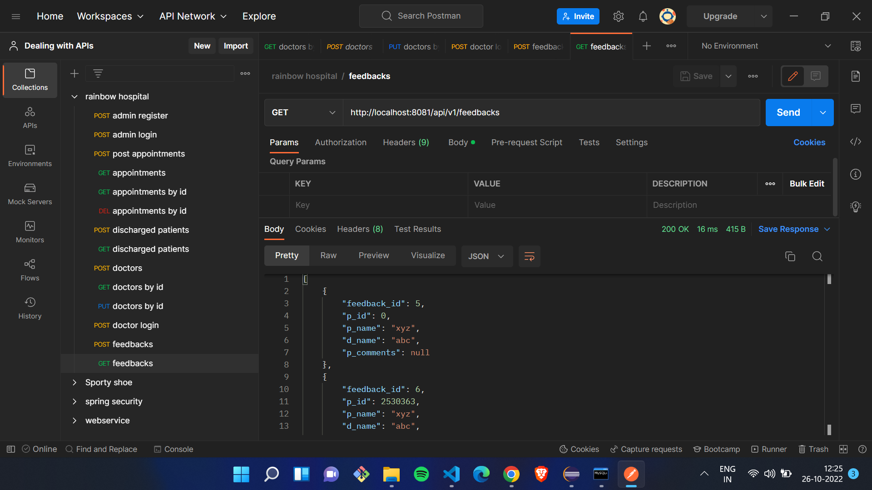

Slide 37
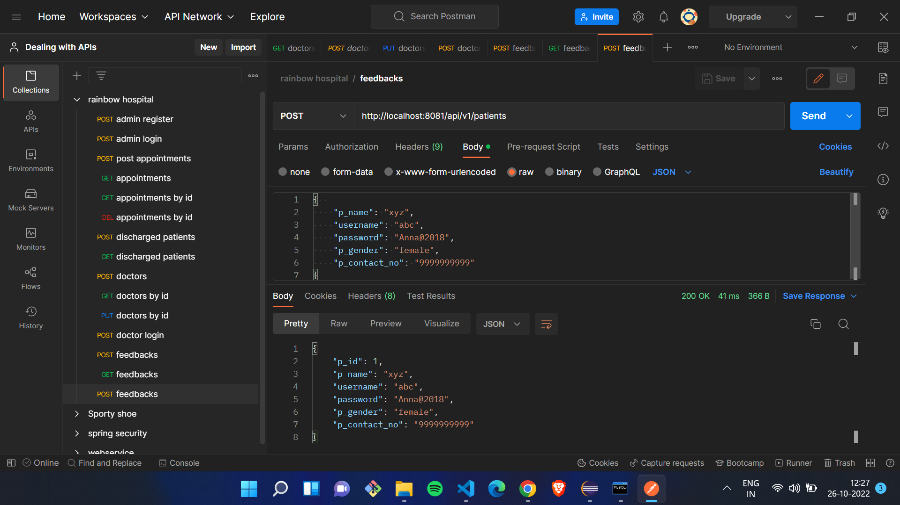

Slide 38
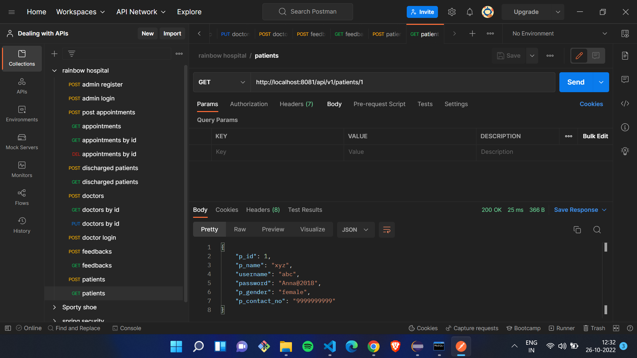

Slide 39
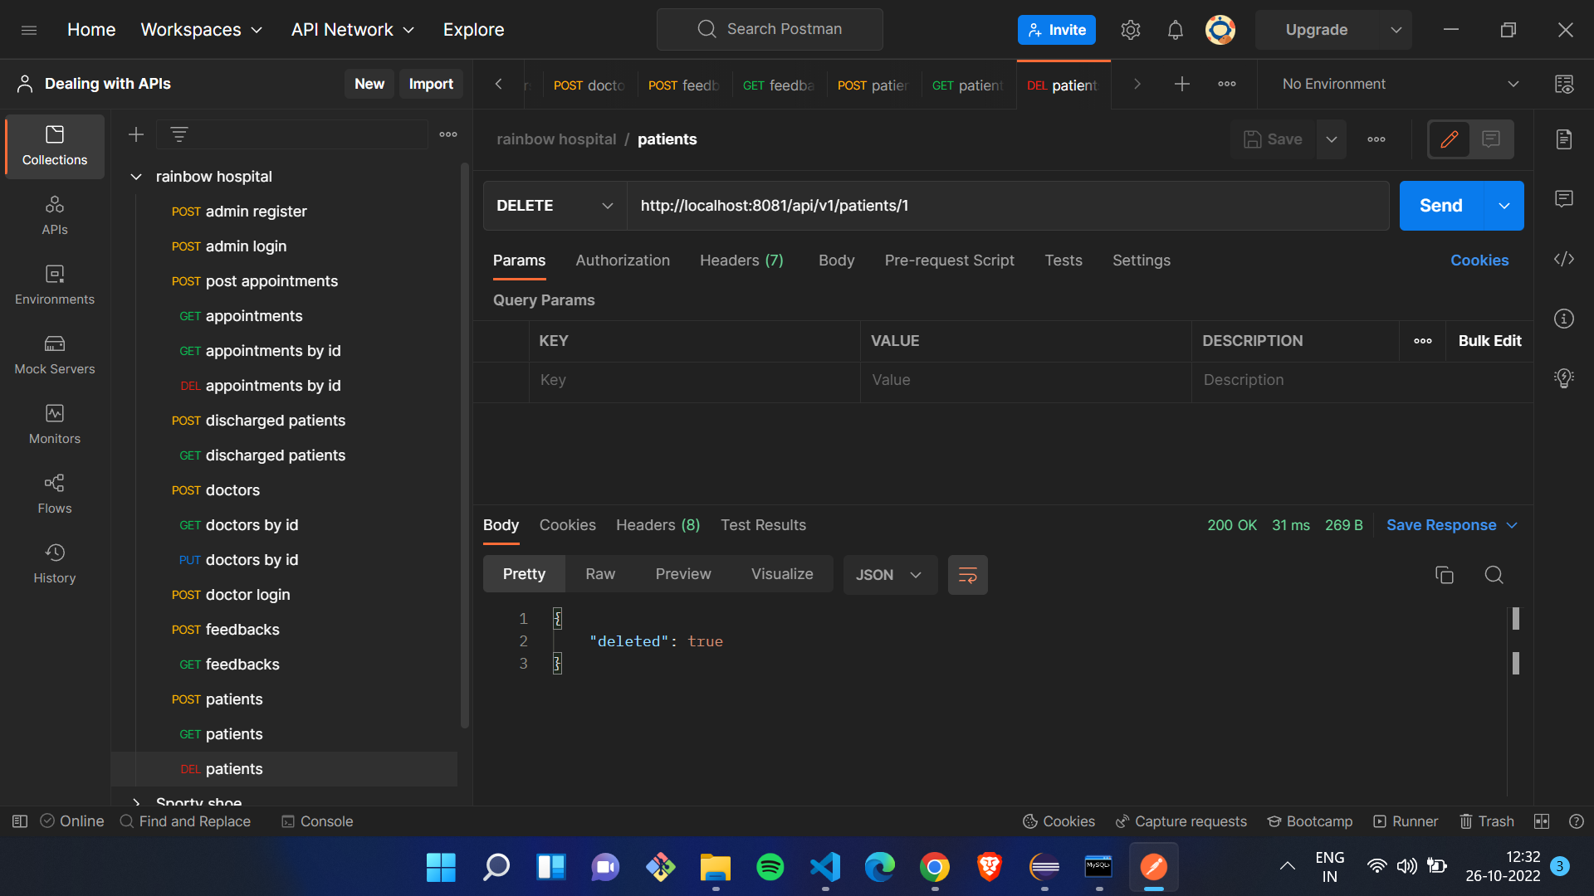

Slide 40
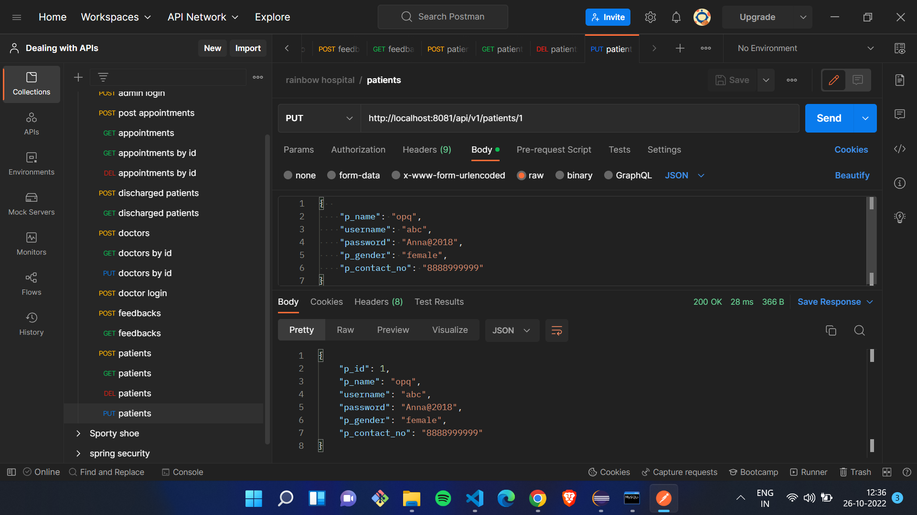

Slide 41
Conclusion
The hospital management system is an inevitable part of the lifecycle of the modern medical institution. It automates numerous daily operations and enables smooth interactions among users. Developing the hospital system software is a great opportunity to create a distinct, efficient, and fast-delivering healthcare model. Implementation of a hospital management system project helps to store all kinds of records, provide coordination and user communication, implement policies, improve day-to-day operations, arrange the supply chain, manage financial and human resources, and market hospital services. This beneficial decision covers the needs of the patients, staff, and hospital authorities and simplifies their interactions. It has become the usual approach to managing the hospital.

Slide 42
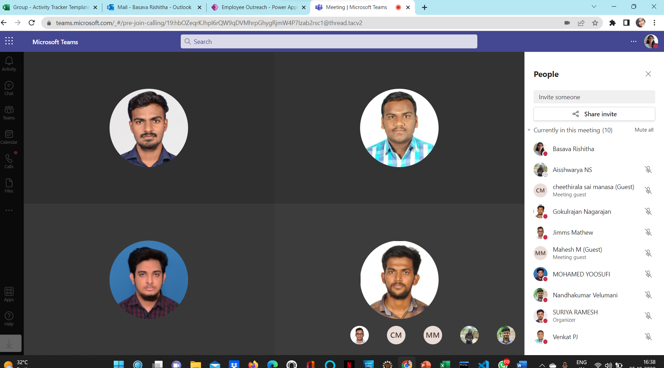
Meetings

Slide 43
References
YouTube
www.stackoverflow.com
www.w3school.com
www.google.com
www.angular.io
https://www.partech.nl/nl/publicaties/2020/07/9-trending-best-practices-for-rest-api-development.com

Slide 44


